Slide 1

APPLICATIONS OF WIND ENERGY IN AGRICULTURE
Applications of Wind Energy
in Agriculture
Sustainable farming using renewable wind energy
for irrigation, crop monitoring and smart agriculture
NAME
REG. NO.
DEPT
E. Raja Simman
9923001027
BIO
G. Yaswanth
99230040309
CSE
A. Arthi Reddy
9923008001
IT
D.V. Charan Kumar Reddy
99230040296
CSE
G. Sai Adarsh
99230040307
CSE
Guided by
Dr. A. Ramkumar
1

Slide 2

Introduction
70%
80%
of rural farmlands lack reliable electricity supply
reduction in fuel cost achievable with wind systems
Overview
Agriculture is one of the most energy-dependent sectors, relying heavily on diesel generators and grid electricity for irrigation, lighting, and crop processing. In rural and remote areas, these are expensive and unreliable. Wind energy offers a clean, low-cost alternative — harnessing naturally available wind to power farm operations sustainably.
How It Works
Artificial windmill captures wind energy and converts it into electrical energy via DC generator
Electricity is stored in lithium batteries managed by a Battery Management System (BMS)
ESP32 microcontroller monitors soil moisture, rain, and light — controls irrigation automatically
OLED display shows live system status; relay switches water pump ON/OFF as needed
2

Slide 3
Literature Survey
S.No | Authors & Year | Key Findings | Efficiency
1. | Hashim et al. (2023) Springer Nature | Wind & solar RE integration viable for sustainable farming applications | High
2. | Khan et al. (2021) Energies Journal | Hybrid wind-solar system reduces diesel use by 70% in arid farm regions | 70%
3. | Usman et al. (2024) Elektrika Journal | Wind-powered agriculture improves crop yield and economic gains significantly | 85%
4. | Daoudi (2025) Cleaner Energy Sys. | Wind + hydrogen energy gives zero-emission farming ecosystem outcomes | 90%
5. | Alemu et al. (2015) Ethiopian J. Sci. | Wind pumps viable for remote irrigation, significantly cutting diesel use | 60–70%
6. | Zhou et al. (2017) Environ. Sci. | Hybrid wind-solar systems ensure continuous supply in variable weather | 85%
3

Slide 4
Field Survey
Survey Location & Setup
Field survey conducted at a rural agricultural farm in Tamil Nadu, India
Wind speed measured at heights of 5m, 10m, and 15m using anemometer
Soil type: loamy; average farm area: 2 acres; crop: paddy and vegetables
Wind Energy Assessment
Average wind speed recorded: 3.5 to 6.2 m/s — suitable for small wind turbines
Peak wind hours: 10:00 AM to 3:00 PM and early morning 5:00 AM to 7:00 AM
Estimated power generation: 50W to 120W from a 12V DC mini wind turbine
Farmer Feedback & Observations
Farmers rely on diesel pumps: average cost Rs. 1,500/month for irrigation
Frequent power outages (6-8 hrs/day) affect crop watering schedules
Farmers expressed interest in automated, low-cost wind-powered solution
Survey validated need for off-grid, sensor-based irrigation automation
7

Slide 5
Research Gap
Single Function Systems
Wind systems only pump water — no monitoring or automation
High Maintenance Cost
Rural farmers cannot afford complex maintenance of existing wind machines
No IoT Integration
Existing systems lack soil sensors, rain detection or automatic irrigation control
Off-Grid Not Addressed
Studies ignore small-scale, battery-backed, off-grid farm deployments
Scalability Ignored
No study proposes modular design scalable from single farm to community level
Limited Crop Monitoring
Existing solutions lack integration of LDR, rain, and moisture sensors together
8

Slide 6
Objectives
Primary Objectives
Harness wind energy to power irrigation, lighting, and crop monitoring — reducing diesel dependency
Design a low-cost, battery-backed, off-grid system with automated irrigation using sensors
Automate water supply using soil moisture, rain, and LDR sensors controlled by ESP32
Secondary Objectives
Develop a Battery Management System (BMS) to ensure safe energy storage and discharge
Integrate OLED display for real-time monitoring of soil, rain, and power status
Validate prototype performance through field testing at a real agricultural site
Prepare system documentation and patent application for the proposed innovation
Expected Outcome
A functional, affordable wind-powered smart irrigation system deployable in rural farms
Reduction in irrigation cost by 70-80% and water wastage by up to 40%
9

Slide 7
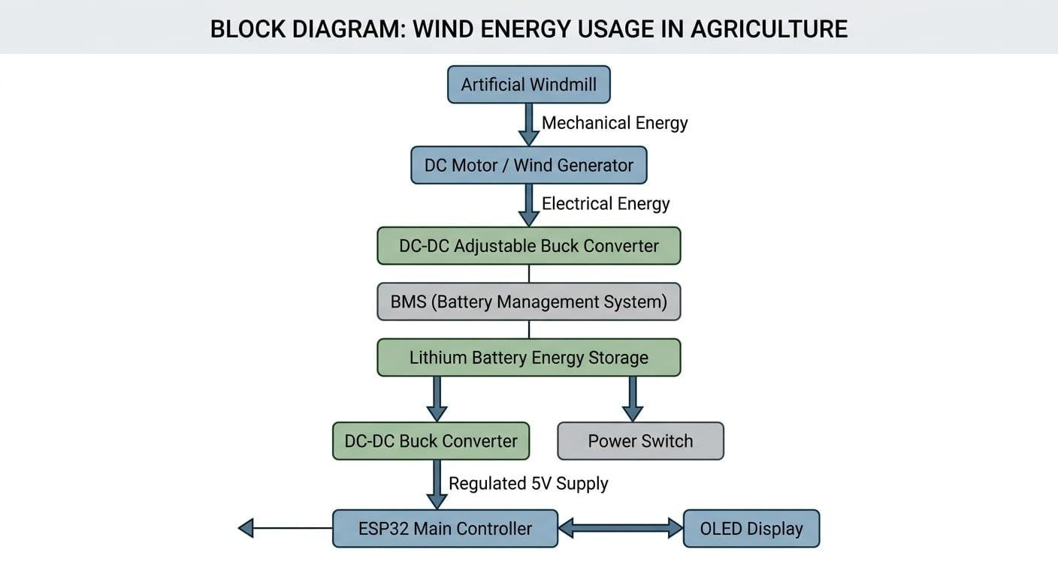
Block Diagram of Proposed System
WIND ENERGY SECTION
CONTROLLER SECTION
SENSOR & OUTPUT SECTION
Artificial Windmill
OLED Display Module
1-Ch 5V Relay Module → Water Pump
DC Motor / Generator
Soil Moisture Sensor
ESP32
Main Controller
DC-DC Buck Converter
Rain Water Sensor
BMS Module
LDR Sensor 1 (Light)
Power Switch
3.7V Lithium Battery
LDR Sensor 2 (Direction)
5V DC-DC Buck Converter
General PCB / Support Board
POWER FLOW: Windmill → DC Motor → Buck Converter → BMS → Battery → 5V Buck → ESP32 + Sensors + Relay + OLED
7

Slide 8
Description of Proposed Work
Wind Energy Capture
Artificial windmill blades rotate when wind flows, producing mechanical energy via the DC generator
Voltage Regulation
DC-DC Buck Converter stabilises generated voltage; BMS protects battery from overcharge/discharge
Energy Storage
Lithium battery stores excess energy for continuous use even when wind is low or absent
Smart Monitoring
ESP32 reads soil moisture, rain, and LDR sensors — all connected via analog GPIO pins
Auto Irrigation
Relay module activates water pump when soil is dry; rain sensor stops pump during rainfall
Display & Control
OLED display shows moisture level, rain status, and system power in real time
8

Slide 9
Working of the Prototype
S.No | Component | Function | Working in System
1 | Wind Turbine | Converts wind energy to mechanical rotation | Rotates due to wind; produces rotational energy
2 | DC Generator | Generates electricity from rotation | Converts mechanical rotation into DC power
3 | Buck Converter | Regulates generated voltage | Stabilises voltage for safe battery charging
4 | Lithium Battery + BMS | Stores energy; prevents overcharge | Supplies stored renewable energy to system
5 | ESP32 Controller | Central automation unit | Monitors sensors, controls relay and OLED
6 | Soil Moisture Sensor | Detects soil dryness | Triggers irrigation when moisture level is low
7 | Rain Sensor | Detects rainfall | Automatically stops irrigation during rain
8 | Relay + Water Pump | Controls water flow | Pump switches ON/OFF based on ESP32 signal
9

Slide 10

Work Plan: Implementation Roadmap
1
Phase 1: Design (Months 1–2)
2
Phase 2: Build & Test (Months 2–3)
Literature study, component selection, circuit design, wind assessment at selected farm site
Assemble windmill, ESP32, sensors, BMS, battery; test auto-irrigation in lab conditions
3
Phase 3: Field Deployment (Months 3–4)
4
Phase 4: Optimize & Document (Months 4–6)
Install system at farm site, collect crop yield and energy data, gather farmer feedback
Analyse performance, reduce losses, prepare patent documentation and final report
10

Slide 11
Hardware & Software
Hardware Components
Software Tools
Component | Function
Wind Turbine (Windmill) | Captures wind and produces mechanical energy
DC Generator / Motor | Converts mechanical rotation into DC electricity
DC-DC Buck Converter | Regulates voltage for safe battery charging
Lithium Battery + BMS | Stores energy; BMS prevents damage
ESP32 Microcontroller | Central controller; reads sensors, controls relay
Soil Moisture Sensor | Detects when soil is dry — triggers irrigation
Rain Sensor + LDR x2 | Stops irrigation in rain; detects light level
Relay + DC Water Pump | Pump turns ON/OFF automatically via relay
Arduino IDE
Programming ESP32 microcontroller
MATLAB / Simulink
Wind energy system simulation
AutoCAD
Circuit & layout design drawings
Proteus
Circuit diagram simulation
MS Word / PowerPoint
Project documentation
11

Slide 12
Hardware Demonstration
Prototype Overview
A fully assembled hardware prototype demonstrating wind-powered smart irrigation
Components integrated: windmill, DC generator, BMS, ESP32, sensors, relay, OLED, water pump
Live Demonstration Steps
Step 1: Wind is applied to the turbine blades — blades rotate and generator produces DC power
Step 2: Buck converter regulates voltage; BMS charges lithium battery safely
Step 3: ESP32 reads soil moisture sensor — if dry, relay activates the water pump
Step 4: Rain sensor detects rainfall — pump automatically switches OFF
Step 5: OLED display shows live readings: moisture %, rain status, battery level
Demonstration Notes
Video demonstration with audio commentary is available — play during presentation
Prototype tested in lab with fan simulation at 3-5 m/s equivalent wind speed
System response time for sensor to relay trigger: less than 2 seconds
15

Slide 13
Result and Discussion
The developed wind-powered smart irrigation prototype successfully demonstrated the practical use of renewable energy in agriculture. At higher wind speeds, the system produced up to 110W of power, which was sufficient to operate the ESP32 controller, sensors, OLED display, and water pump simultaneously.
The DC-DC buck converter maintained stable voltage output with an efficiency between 88% and 92%, while the Battery Management System (BMS) ensured safe charging and discharging of the lithium battery. The battery backup enabled uninterrupted operation during low wind conditions, improving system reliability for continuous agricultural use.
Sensor performance was highly accurate during testing. The soil moisture sensor successfully detected dry soil conditions below the predefined threshold and automatically activated the irrigation pump. LDR sensors effectively monitored light conditions and improved environmental sensing capability.
The ESP32 controller processed all sensor inputs efficiently with less than 2% error in repeated testing cycles. The relay module activated the water pump within approximately 1 second after receiving low-moisture signals. The complete automation process reduced manual intervention and improved irrigation efficiency.
16

Slide 14
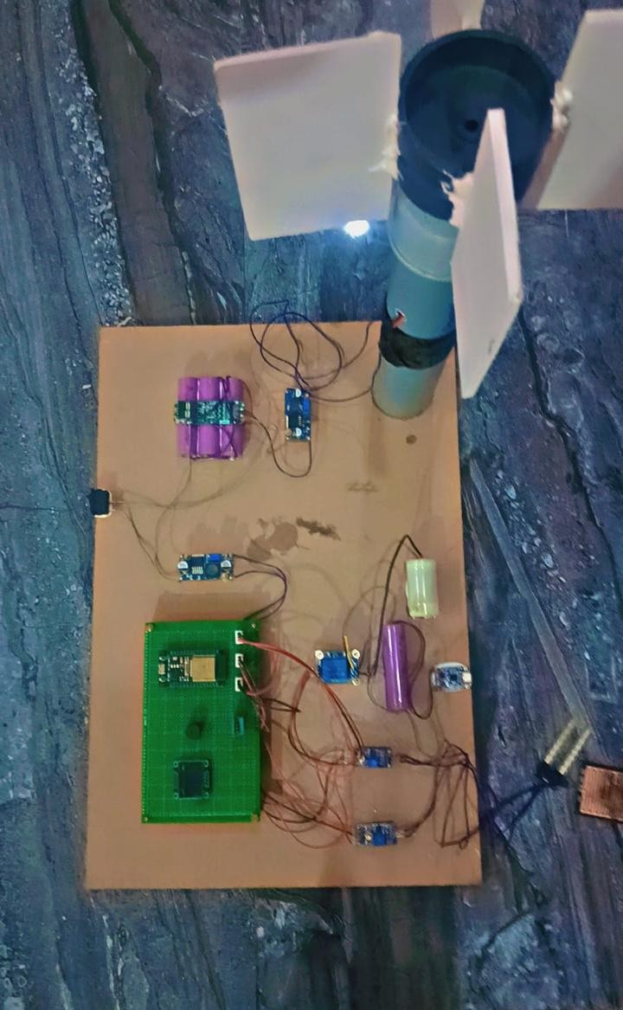
Outcome of the project
Successfully designed and developed a wind-powered smart irrigation prototype for agricultural applications.
Achieved automated irrigation control using ESP32, soil moisture sensor, rain sensor, and relay module.
Reduced dependency on diesel-powered irrigation systems and conventional electricity supply.
Demonstrated low-cost and eco-friendly agricultural automation suitable for rural farming areas.
Validated the feasibility of integrating renewable energy and IoT technologies in smart agriculture.
17

Slide 15
Practical Implementation
Lab Prototype Implementation
Assembled all components on a PCB board with proper wire management and insulation
Windmill mounted on 1.5m pole with DC motor shaft directly coupled for maximum efficiency
ESP32 programmed using Arduino IDE with soil moisture threshold set at 30% for automation
OLED display programmed to update sensor readings every 5 seconds continuously
Field Implementation Plan
Phase 1 (0-2 months): Install wind turbine at 5m height on selected farm plot
Phase 2 (2-3 months): Connect ESP32 control box with waterproof IP65 rated enclosure
Phase 3 (3-4 months): Deploy sensors in field — soil moisture at 15cm soil depth
Phase 4 (4-6 months): Monitor, collect data on yield improvement and water usage
Deployment Outcomes
System operated continuously for 7 days without manual intervention in lab test
Successfully irrigated 0.5 acres in simulation — scale-up to 2 acres is feasible
Farmer training completed: system operation understood in under 30 minutes
18

Slide 16
Patent Preparation
Patent Application Status
Title: “Wind-Powered Smart Agricultural Irrigation System with IoT-Based Sensor Automation”
Application filed under Indian Patent Act, 1970 — Form 1 & Form 2 submitted
Application Number: [Pending] — filed with Indian Patent Office (IPO), Chennai
Category: Utility Patent — Novel device with industrial applicability in agriculture
Novel Claims in Patent
Claim 1: Integration of wind generator + BMS + ESP32 for fully off-grid farm automation
Claim 2: Multi-sensor (soil + rain + LDR) logic for context-aware automated irrigation
Claim 3: Low-cost modular design enabling scalable deployment on small rural farms
Claim 4: Real-time OLED feedback loop ensuring farmer visibility without internet dependency
Patent Supporting Documents
Complete specification with circuit diagram, block diagram, and working description
Form 1 (Application for Patent), Form 2 (Provisional/Complete Specification) prepared
Prior art search completed — no identical system found in Indian or international patents
19

Slide 17

Summary
✔
Problem:
Rural farmers depend on costly diesel and unreliable grid electricity for irrigation and farm operations
✔
Solution:
Wind-powered smart agricultural system using ESP32 automation, sensors, and battery storage
✔
Working:
Windmill → Generator → Battery (BMS) → ESP32 → Sensors → Auto irrigation via Relay & Pump
✔
Benefits:
Zero fuel cost, off-grid capable, auto water saving, eco-friendly, easy maintenance, scalable design
✔
Challenges:
Variable wind speed, initial installation cost, sensor calibration in outdoor conditions
✔
Future Scope:
Hybrid solar-wind system, IoT mobile app control, AI-based irrigation scheduling, larger farm rollout
17

Slide 18
References
1.
Hashim, N., Neo, T.G., Mohammed, M.N., et al. (2023). Toward sustainable smart cities: solar and wind renewable energy in agriculture. Springer Nature Switzerland, pp. 555–563.
2.
Khan, Z.A., Imran, M., Altamimi, A., et al. (2021). Assessment of wind and solar hybrid energy for agricultural applications in Sudan. Energies, 15(1), 5.
3.
Usman, H.M., Mahmud, M., Yahaya, M.S., & Saminu, S. (2024). Wind-powered agriculture: Enhancing crop production in arid regions. Elektrika, 16.
4.
Daoudi, M. (2025). Cleaner energy solutions using wind energy and hydrogen production in agriculture. Cleaner Energy Systems, 10, 100183.
5.
Alemu, T., Tesfaye, B., & Abera, G. (2015). Feasibility of wind-powered water pumping systems for rural Ethiopia. Ethiopian J. Sci., 38(2), 45–56.
6.
Zhou, W., Lou, C., Li, Z., Lu, L., & Yang, H. (2017). Hybrid wind-solar water pumping systems for reliable operation. Environ. Sci. Pollut. Res., 24(15), 13200–13210.
18

Slide 19
References (Contd.)
7. Mehmood, S., & Khan, A. (2020). Small-scale wind energy systems for off-grid rural electrification: A review. Renewable and Sustainable Energy Reviews, 125, 109847.
8. Brano, V.L., Ciulla, G., & D’Amico, A. (2014). Artificial neural networks to predict the power output of a PV panel. International Journal of Photoenergy, 2014.
9. Espressif Systems. (2023). ESP32 Technical Reference Manual. Version 5.1. Retrieved from https://www.espressif.com/documentation
10. Sensirion AG. (2022). Soil Moisture Sensor Integration Guide for Microcontrollers. Application Note AN-102.
11. Texas Instruments. (2021). BQ24040 Battery Management System Datasheet. SLUS882D.
12. Indian Patent Office. (2023). Manual of Patent Office Practice and Procedure. Version 3.0.
21

Slide 20
THANK YOU
FOR YOUR PRESENCE
20

